Slide 1
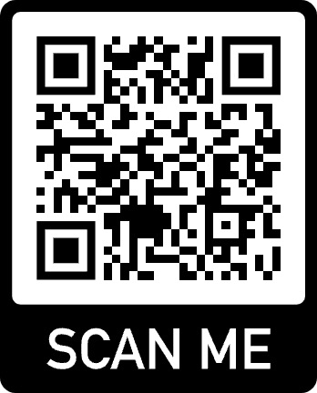

The Second Workshop on
Knowledge Augmented Methods for NLP
(KnowledgeNLP-KDD’23)
1pm-5pm August 6th
Room: Grand A

Slide 2
Why Knowledge for NLP?
Language models are being developed and deployed in many applications.
Limitations and safety issues are mainly caused by missingness of knowledge.
Knowledge includes commonsense, world facts, domain expertise, persona, and especially unique patterns that need to be discovered from big data applications.
Integrating knowledge into the training and inference processes of language models has emerged as a compelling need.
Challenge #1: Knowledge is diverse and distributed across various resources. How to acquire relevant knowledge for language models/tasks?
Challenge #2: How to effectively represent and use the acquired knowledge to improve language model performance?
Challenge …

Slide 3
The History of the Workshop
Survey paper: “A survey of knowledge-enhanced text generation.” ACM Computing Surveys, 2022.
Tutorial #1: Knowledge-Enriched Natural Language Generation. EMNLP 2021.
Tutorial #2: Knowledge-Augmented Methods for NLP. ACL 2022.
Tutorial #3: Knowledge-Augmented Methods for NLP. WSDM 2023.
Workshop 1: The First workshop on Knowledge Augmented Methods for NLP (KnowledgeNLP-AAAI), 2023. https://knowledge-nlp.github.io/aaai2023/
Today: The Second workshop on Knowledge Augmented Methods for NLP (KnowledgeNLP-KDD), 2023. https://knowledge-nlp.github.io/kdd2023/

Slide 4

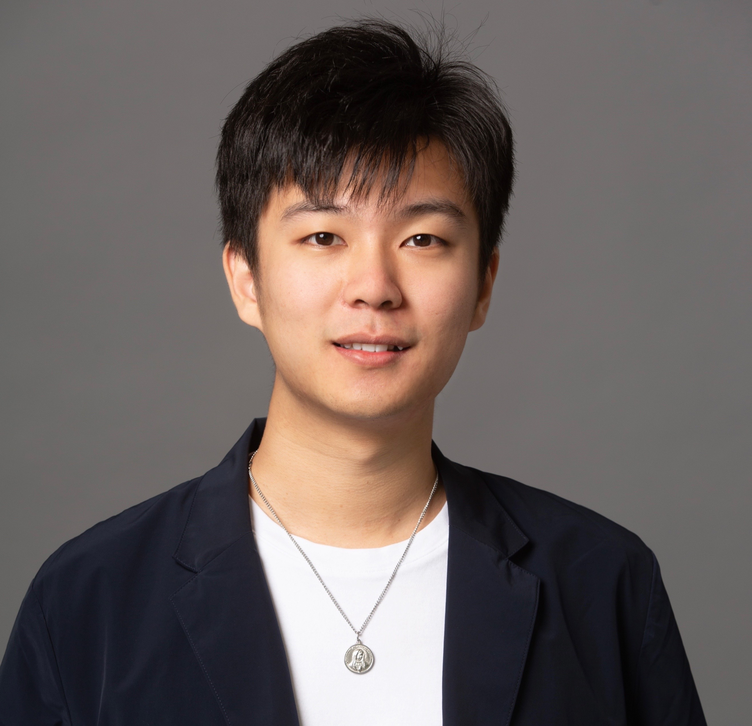
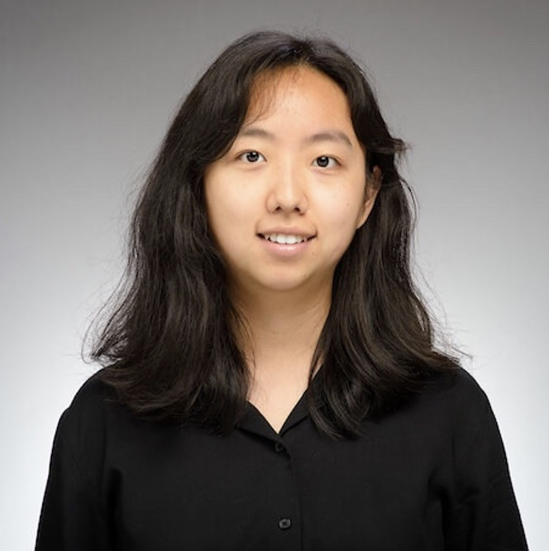
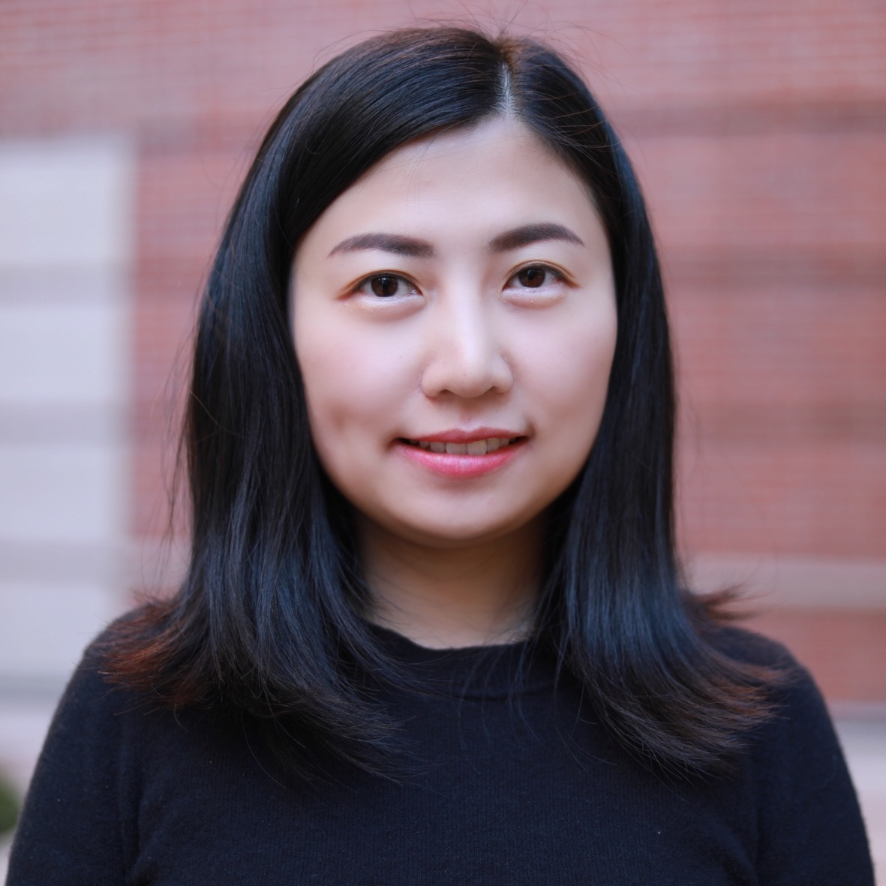
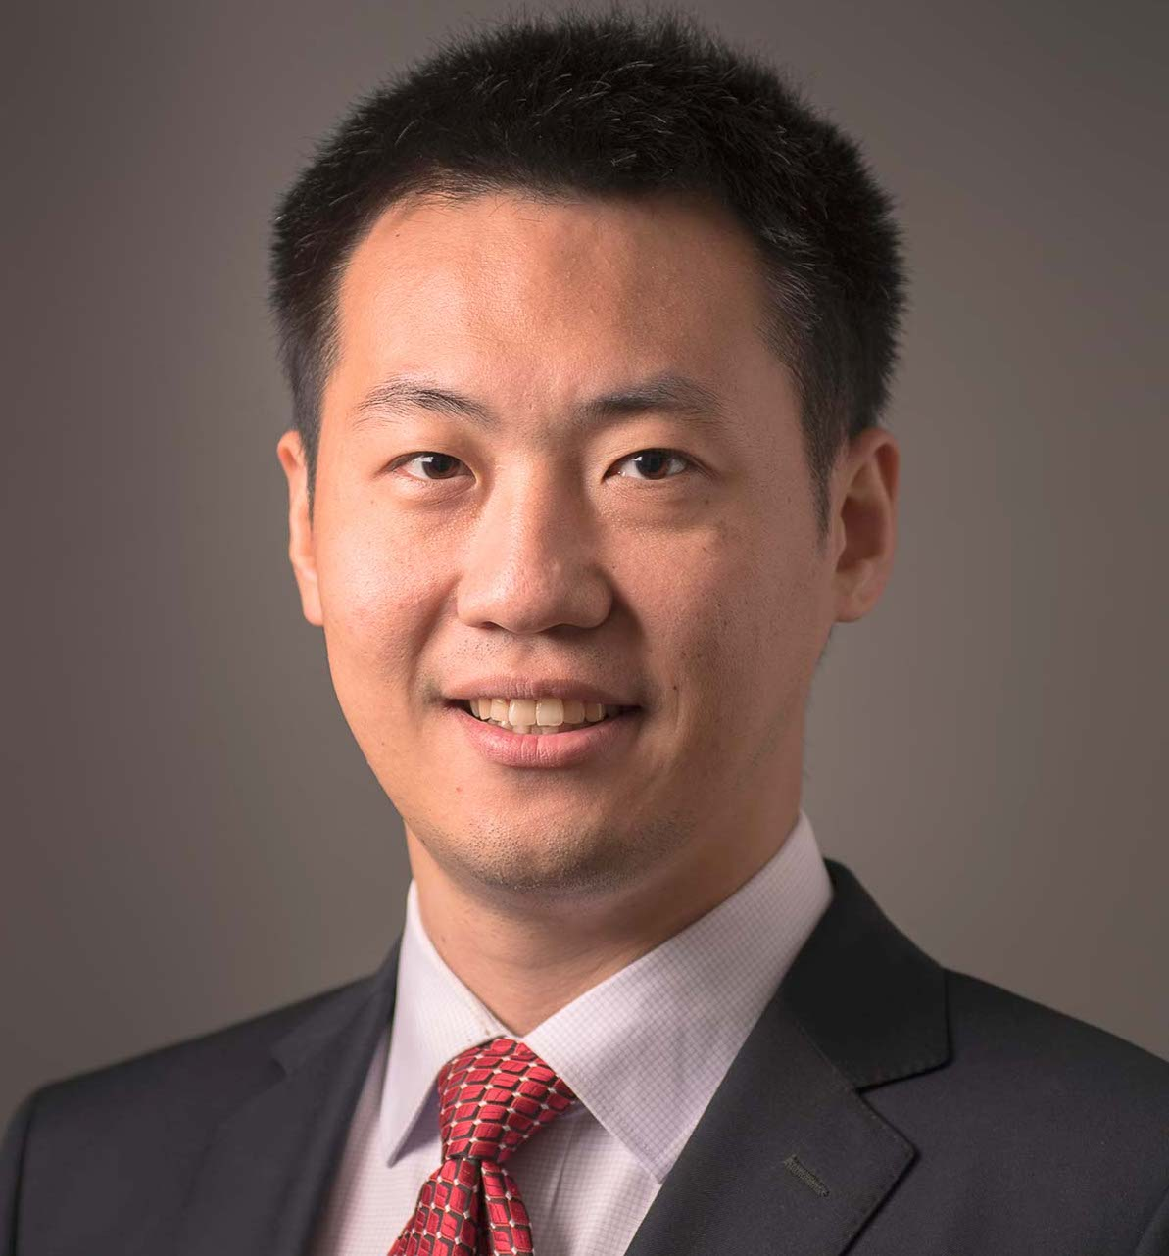
KnowledgeNLP Organizers
In-Person Organization Pre-Workshop
Weijia Shi
(University of Washington)
Wenhao Yu
(University of Notre Dame)
Lingbo Tong
(University of Notre Dame)
Nanyun Peng
(UCLA)
Meng Jiang
(University of Notre Dame)

Slide 5
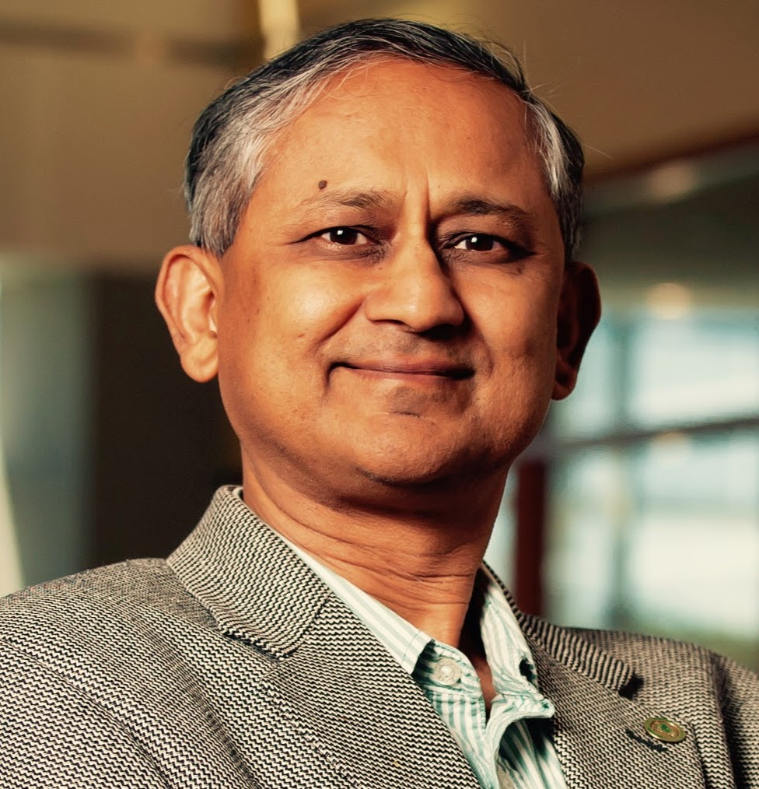
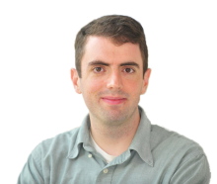
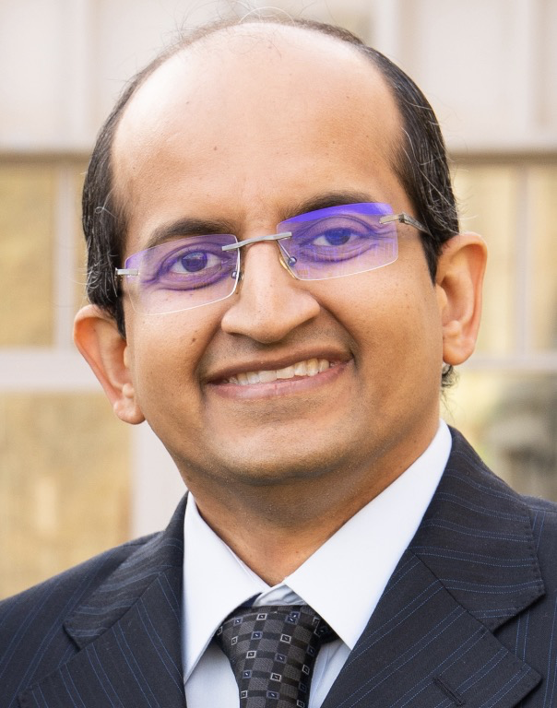
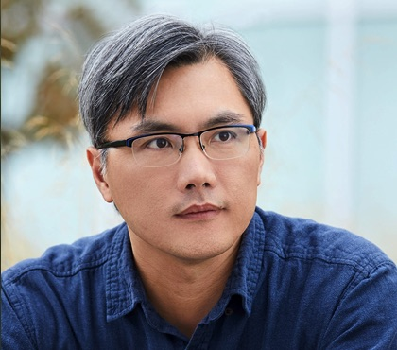
KnowledgeNLP-AAAI’23 Summary
Full Day
50+ in-person and 20+ online participants
Focus: Methodologies of knowledge augmentation, e.g., Joint per-training
Eight oral presentations
Keynote speakers:
Prof. Amit Sheth
(Univ. of South Carolina)
Prof. Jordan Boyd-Graber
(Univ. of Maryland)
Prof. Chandan Reddy
(Virginia Tech)
Dr. Scott Wen-tau Yih
(Meta) online

Slide 6
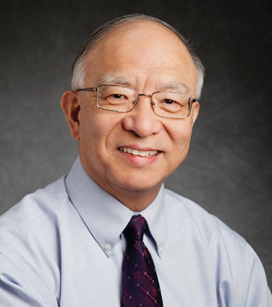
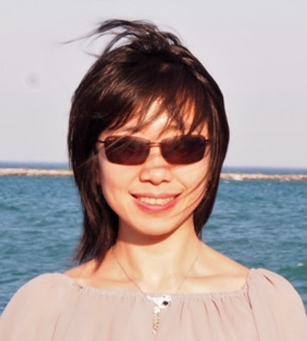
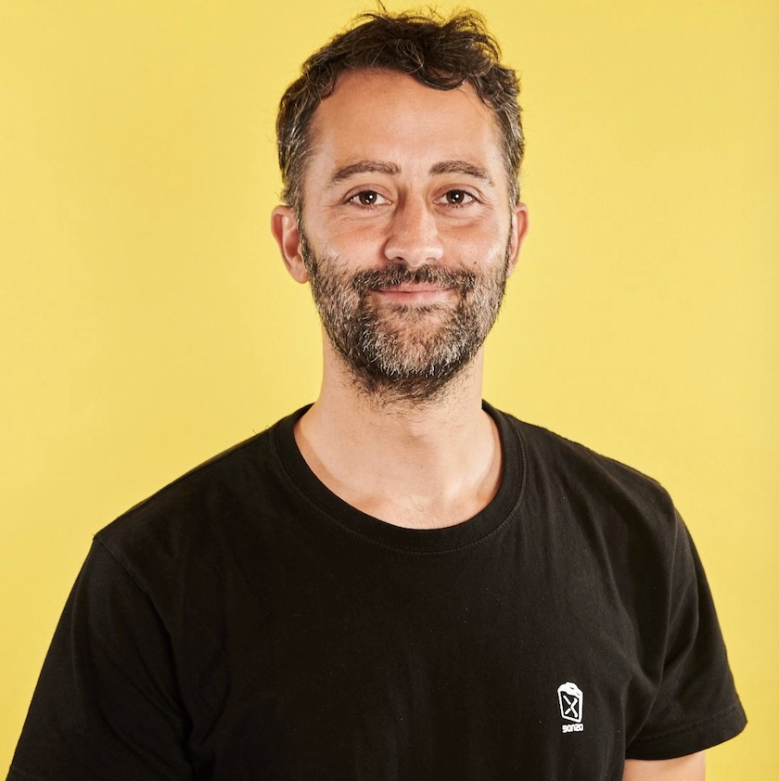
Today! KnowledgeNLP-KDD’23
Half Day (1pm - 5pm)
Focus: KnowledgeNLP in Big Data Applications, e.g., data diversity
Four oral presentations
Eight poster presentations
Keynote speakers:
Prof. Jiawei Han
(UIUC)
Dr. Xin (Luna) Dong
(Meta)
Dr. Francesco Barbieri
(Snap)

Slide 7
Keynote Speeches
Towards Automatic Construction Theme-Specific Knowledge-Bases Assisted with LLMs
How Knowledgeable are LLMs?
Will Knowledge Graphs be replaced with LLMs?
Prof. Jiawei Han
(UIUC)
Dr. Francesco Barbieri
(Snap)
The Importance of "In the Moment" Knowledge: Contextualizing NLP Models with Time, Location and Weather Information
Dr. Xin (Luna) Dong
(Meta Reality Lab)

Slide 8
Submissions
Academia, Industry, …; USA, China, Indian, Korea, …
Carnegie Mellon University
Emory University
Korea University
Indian Institute of Technology Madras
New York University
Sejong University
Shanghai Jiaotong University
Stanford University
University of California, San Diego
University of Michigan
University of South Carolina
Amazon
Electronics and Telecommunications Research Institute
TCS Research
…

Slide 9
Accepted Papers
Oral Presentations Poster Presentations
TouchUp-G: Improving Feature Representation through Graph-Centric Finetuning
Automatic Question-Answer Generation for Long-Tail Knowledge
PV2TEA: Patching Visual Modality to Textual-Established Product Attribute Extraction
Decker: Double Check with Heterogeneous Knowledge for Commonsense Fact Verification
Tackling the Class Imbalance Challenge for Software Defect Type Classification using Knowledge Augmented Method
DSTEA: Improving Dialogue State Tracking via Entity Adaptive Pre-training
Dense Retrieval of Knowledge Graphs for Question Answering
Knowledge-Infused Self Attention Transformers

Slide 10
Schedule
Pacific Time | Session | Speaker
01:00 - 01:10 (10 mins) | Opening
01:10 - 01:50 (35+5 mins) | Keynote #1 | Jiawei Han (UIUC)
01:50 - 02:30 (35+5 mins) | Keynote #2 | Luna Dong (Meta)
02:30 - 02:45 (12+3 mins) | Oral #1
02:45 - 03:00 (12+3 mins) | Oral #2
03:00 - 03:30 (30 mins) | Poster session and Coffee break
03:30 - 04:10 (35+5 mins) | Keynote #3 | Francesco Barbieri (Snap)
04:10 - 04:25 (12+3 mins) | Oral #3
04:25 - 04:40 (12+3 mins) | Oral #4
04:40 - 05:00 (20 mins) | Closing and Poster session

